Slide 1
Trade War Insights from News
Leo Liu
November 16th, 2018

Slide 2


Objective
Strategic Diplomacy
Wise Investment

Slide 3
General Workflow
News API & Scrapping
Preprocessing
Visualization
LDA Topic Modeling
Sentiment & Similarity Analysis
Future Work: Clustering

Slide 4
LDA Topic Modeling
Topics found:
Economy | Aircraft
Agriculture | Investment
Australia & New Zealand | Journalism
Stock Market | WTO
Energy | High Tech Company
Monetary & Indonesia | Social Media
Taiwan Strait Defense | Luxury Goods
Thailand & Vietnam | Automobile

Slide 5
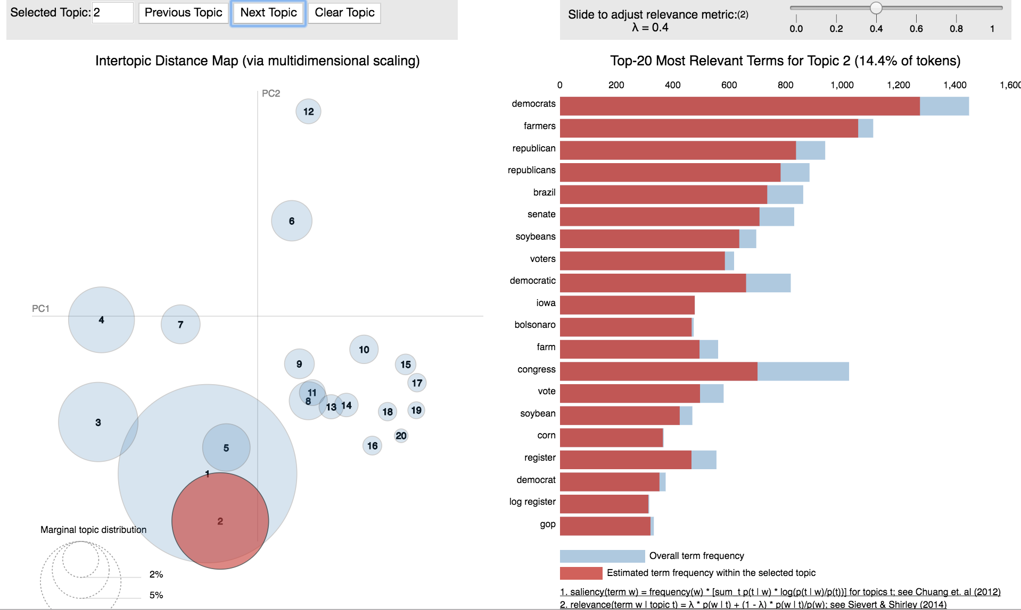
LDA Topic - Agriculture

Slide 6
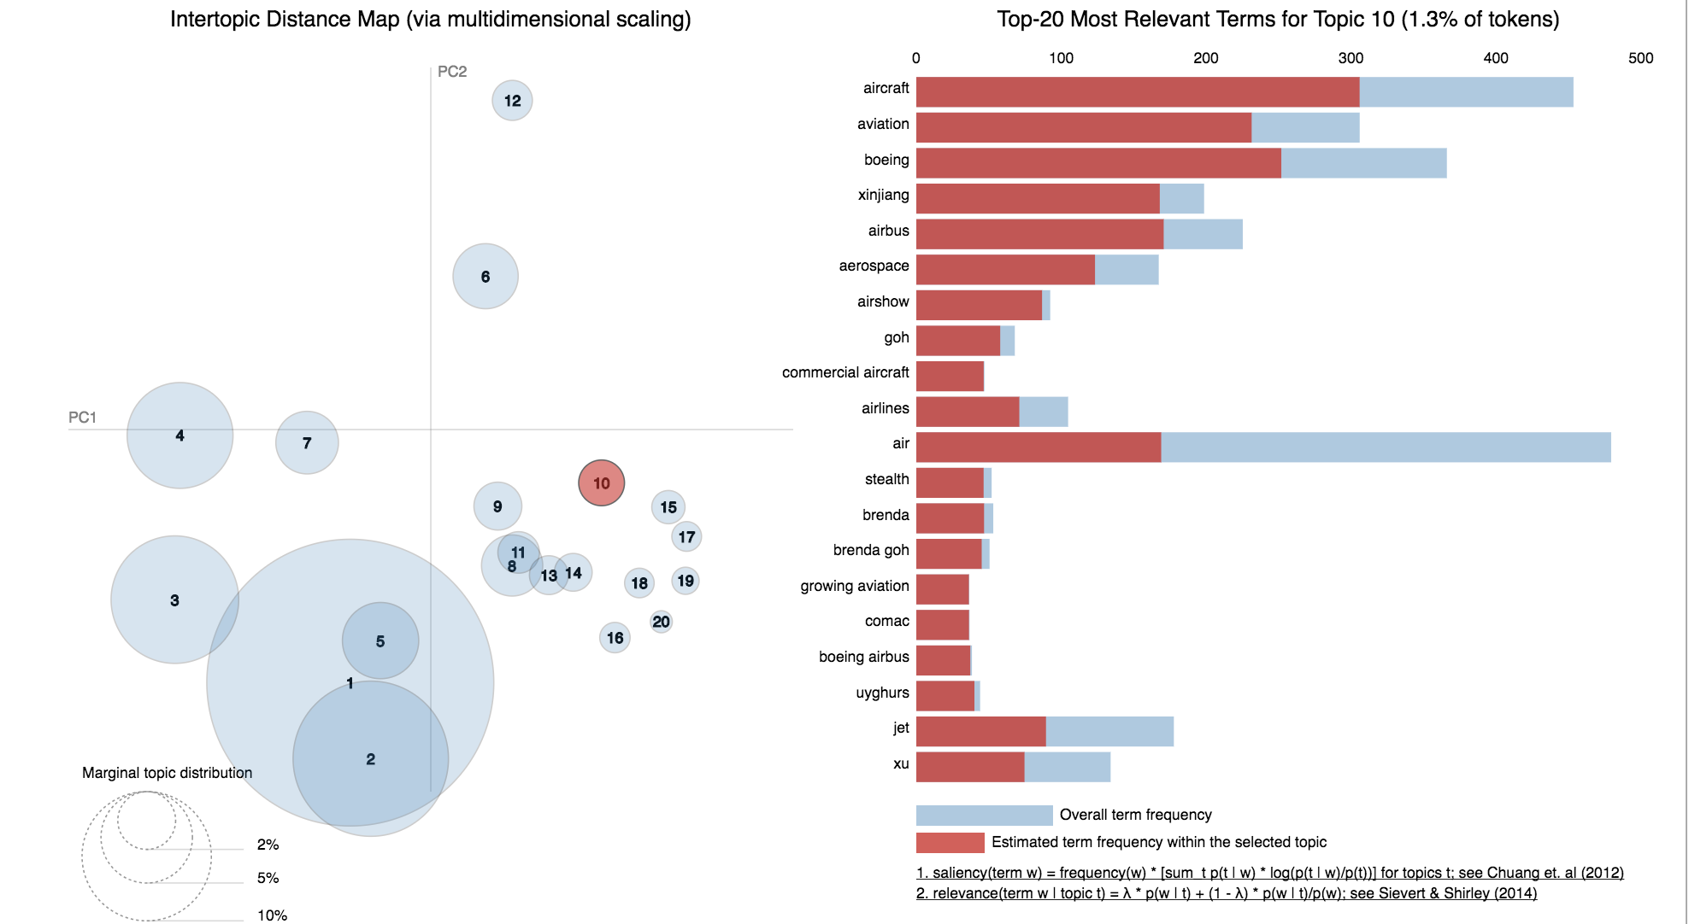
LDA Topic – Aircraft

Slide 7
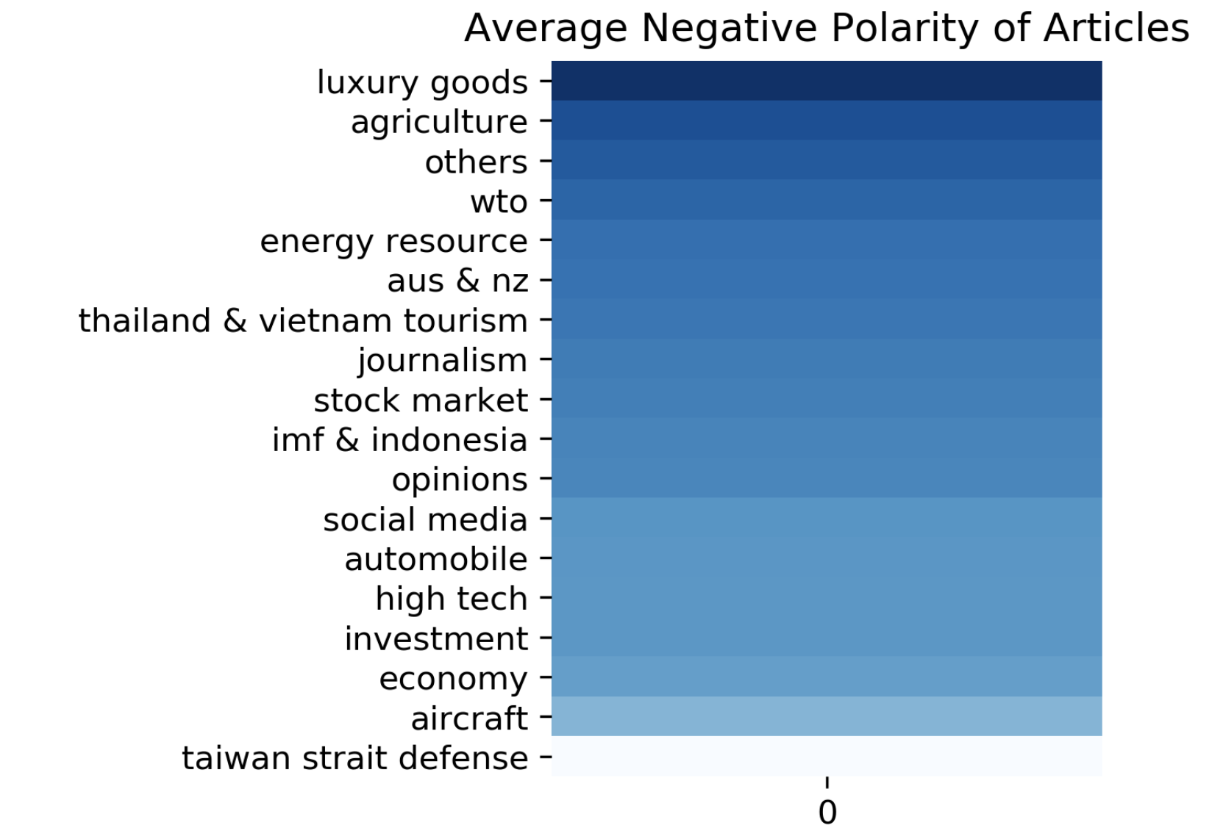
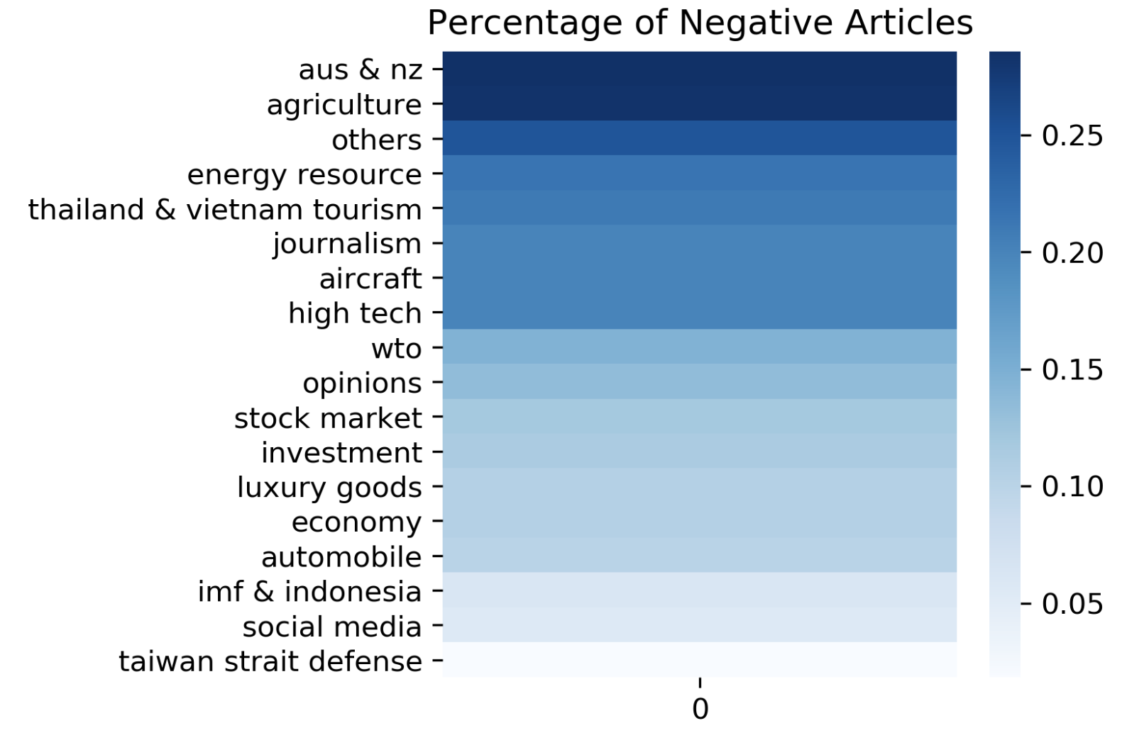
Topic Sentiment Analysis

Slide 8
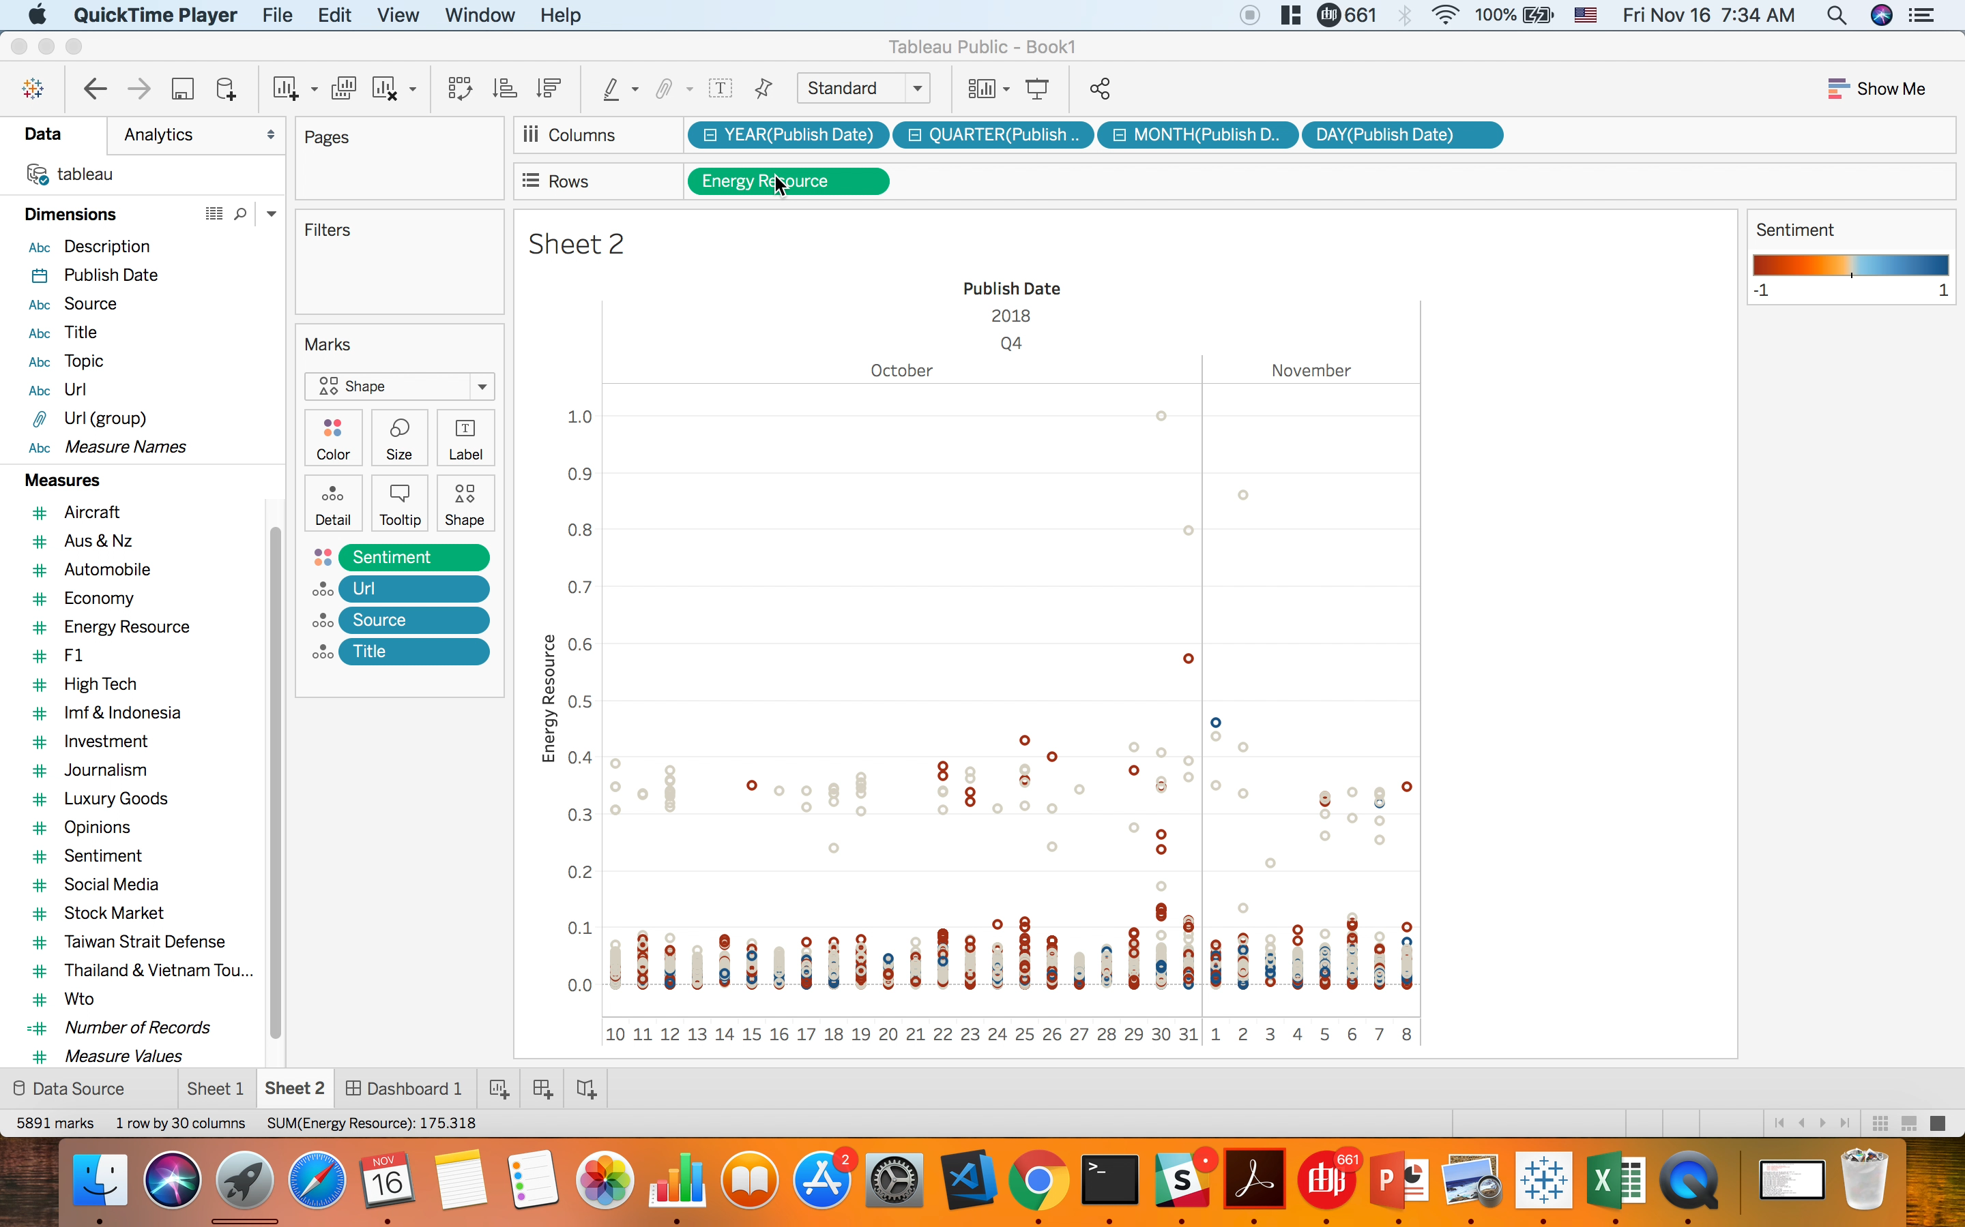
Similarity Analysis – Interactive Dashboard

Slide 9
Future Work
Use better news API if funded to do so
Refine LDA to make topics more generalizable
Choose typical article based on its content
Find some intriguing clusters in Tableau
Build a recommendation system upon users’ query

Slide 10
Thank you
Email: liuriguang@126.com
Linkedin: linkedin.com/leo2506
Github: leo2506

Slide 11
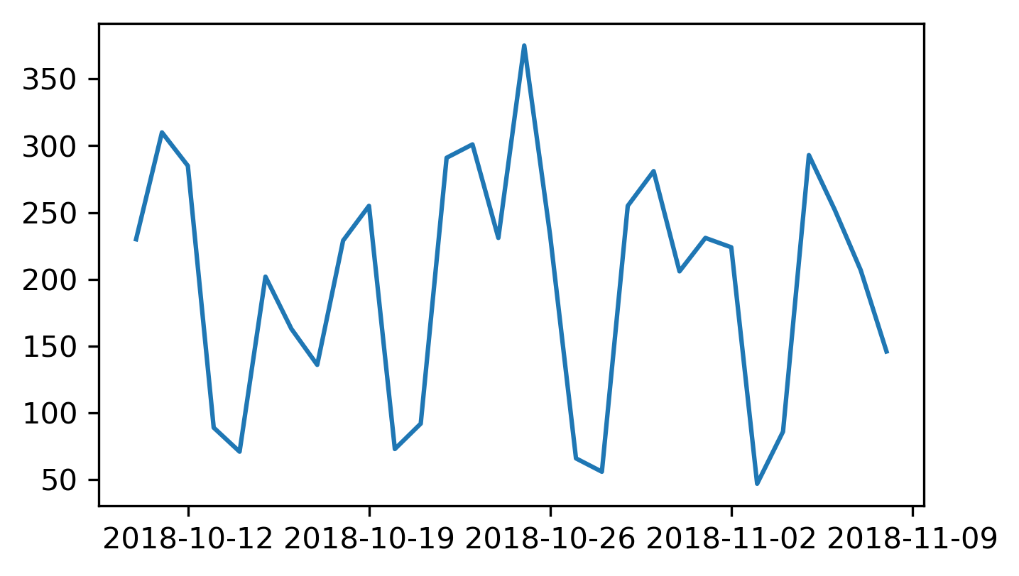
Appendix – Time Plot of Daily News Throughput

Slide 12
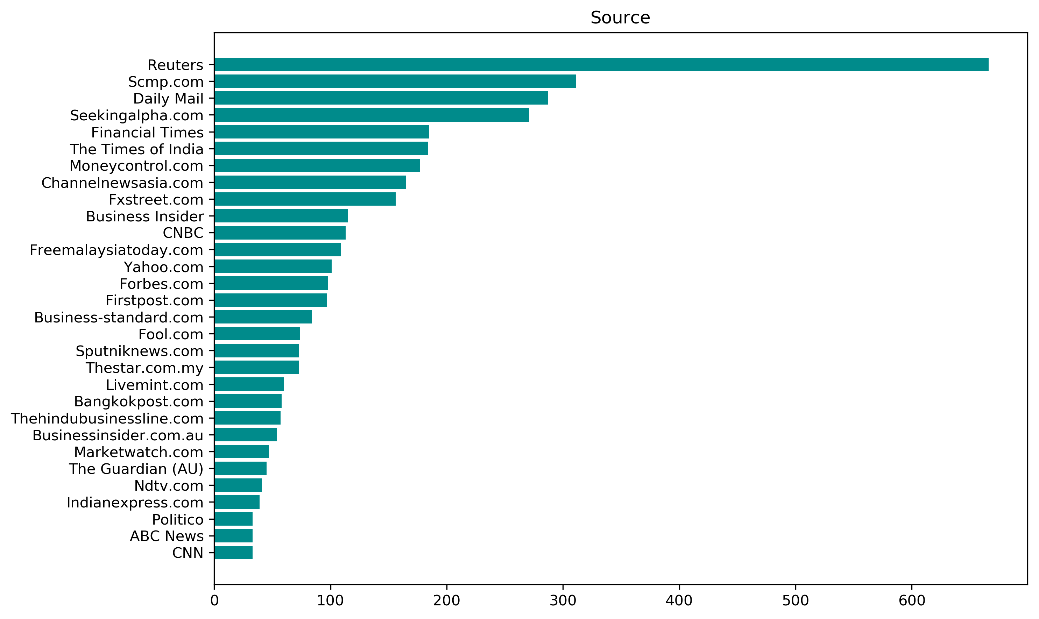
Appendix – Popular News Sources

Slide 13
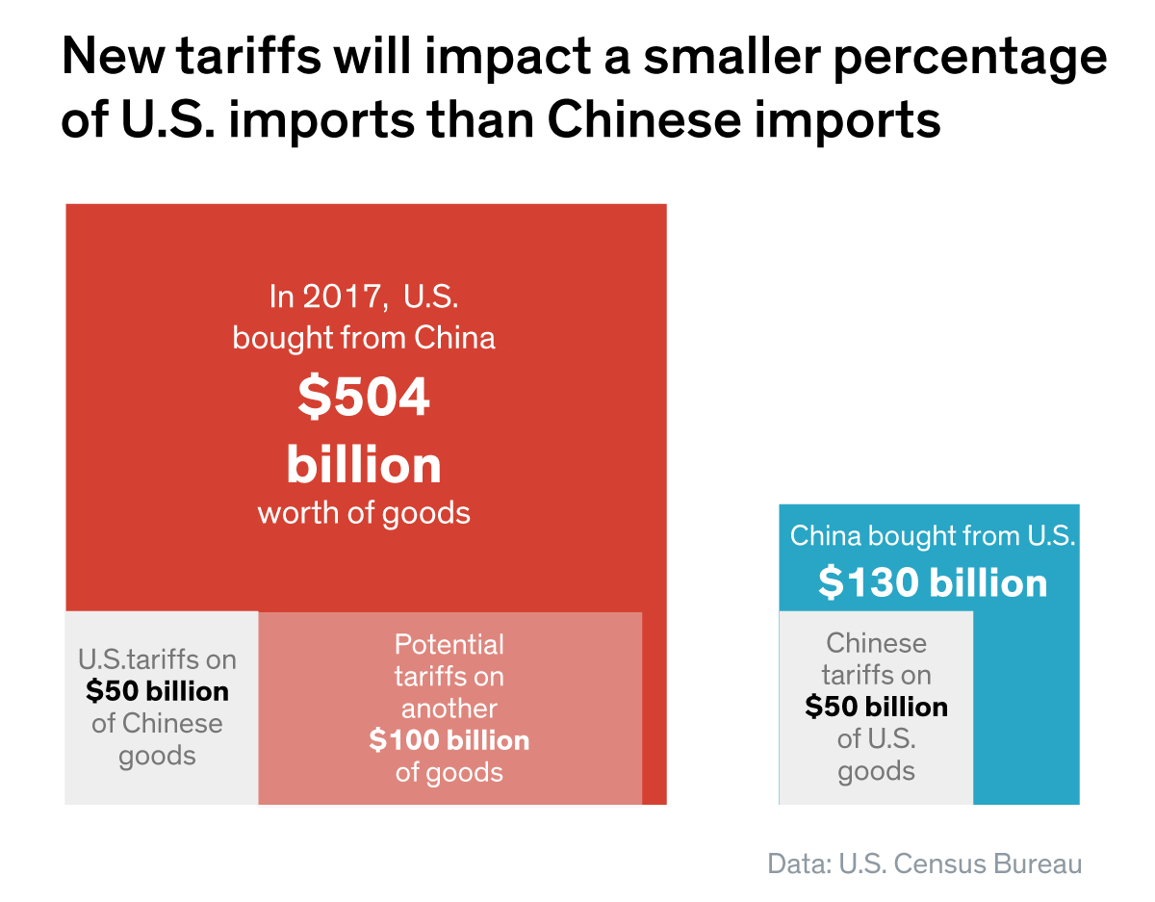
Appendix – U.S. Census Bureau Data

Slide 14
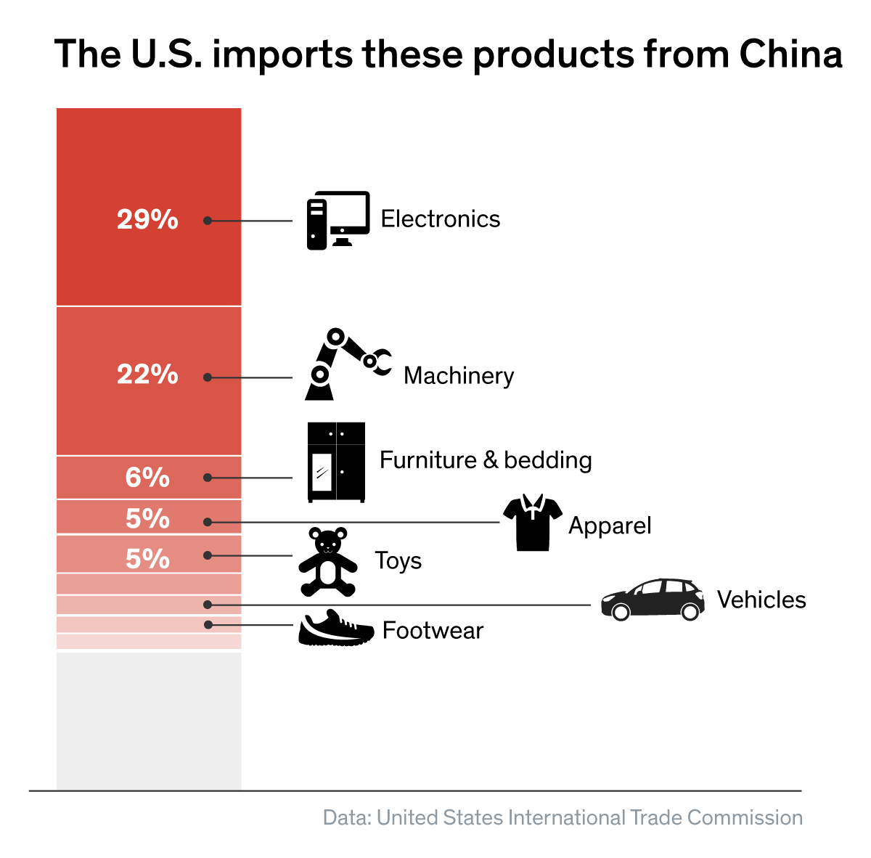
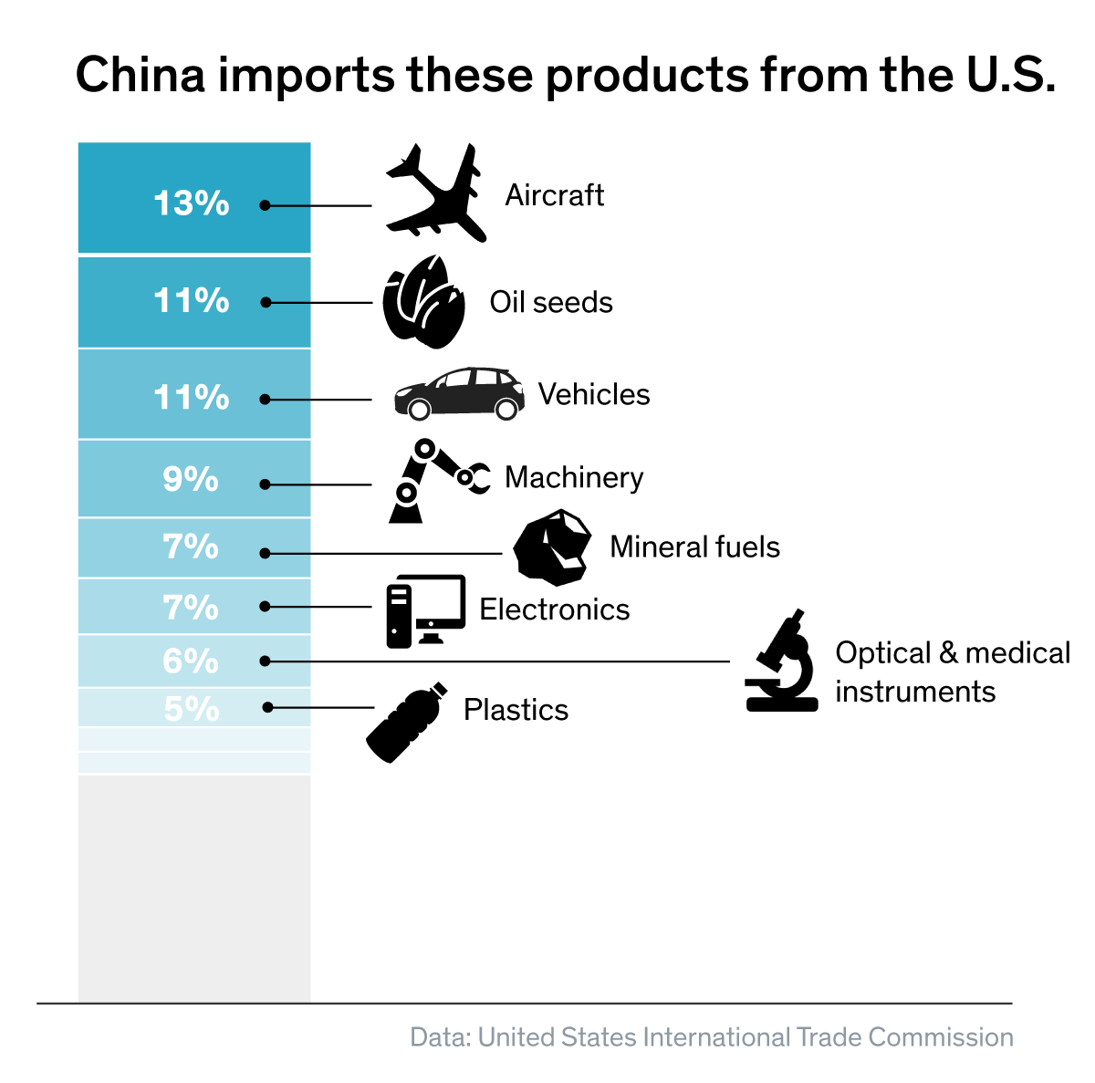
Appendix – U.S. International Trade Commission Data

Slide 15
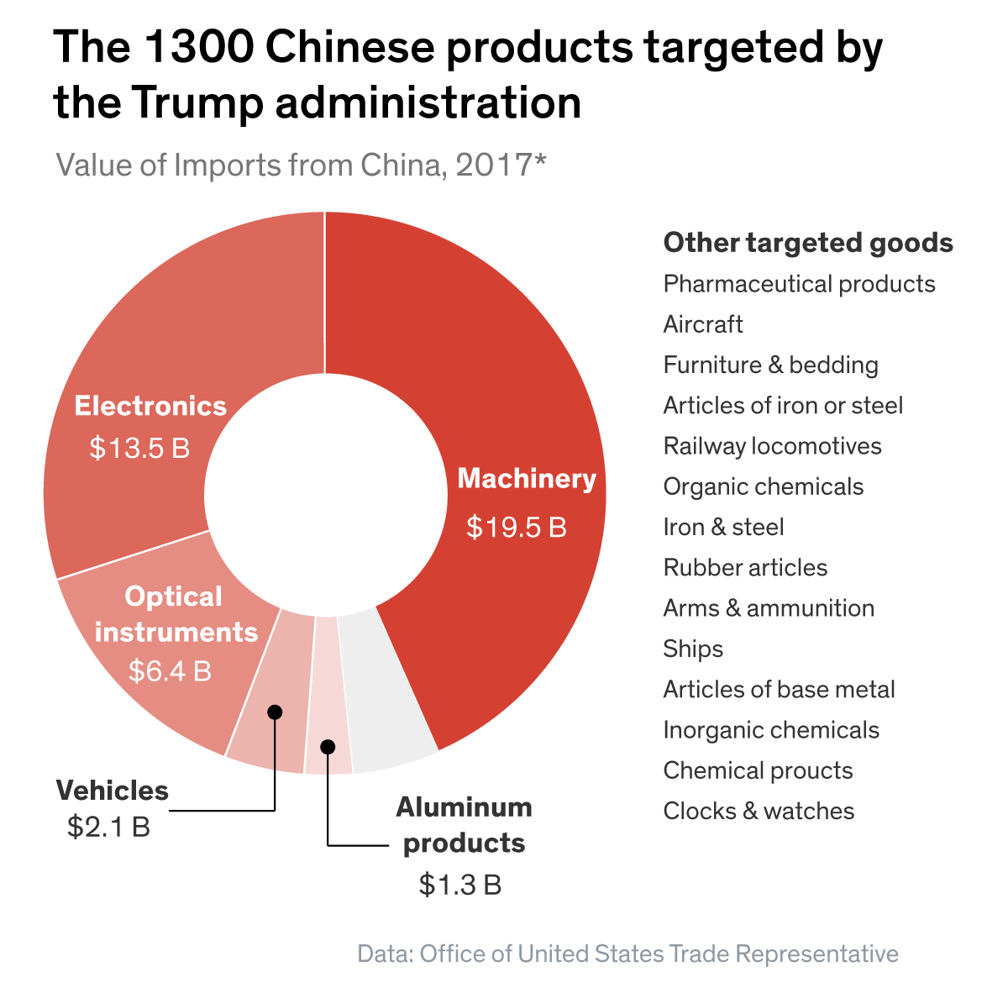
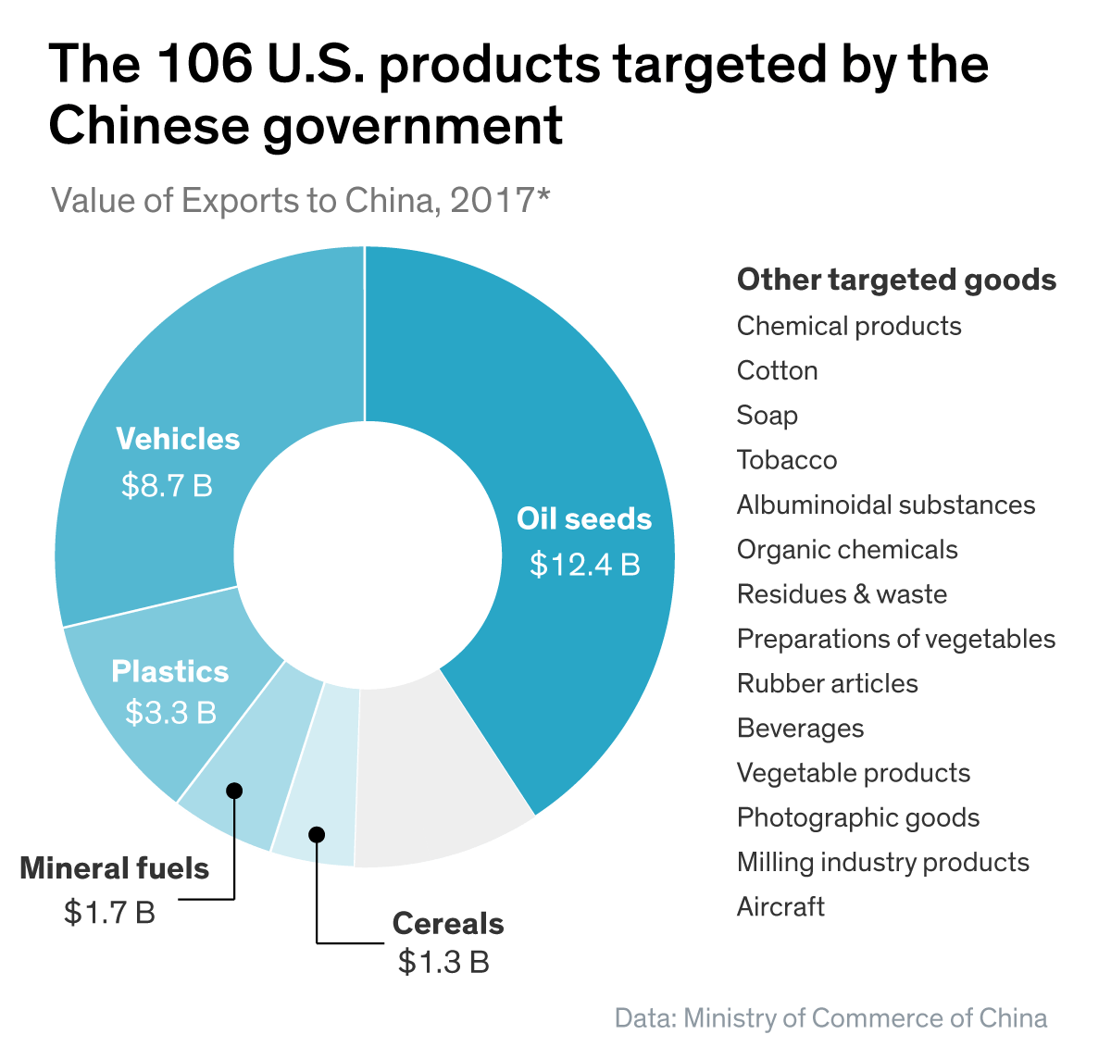
Appendix – U.S. and China Export Amount Data

Slide 16
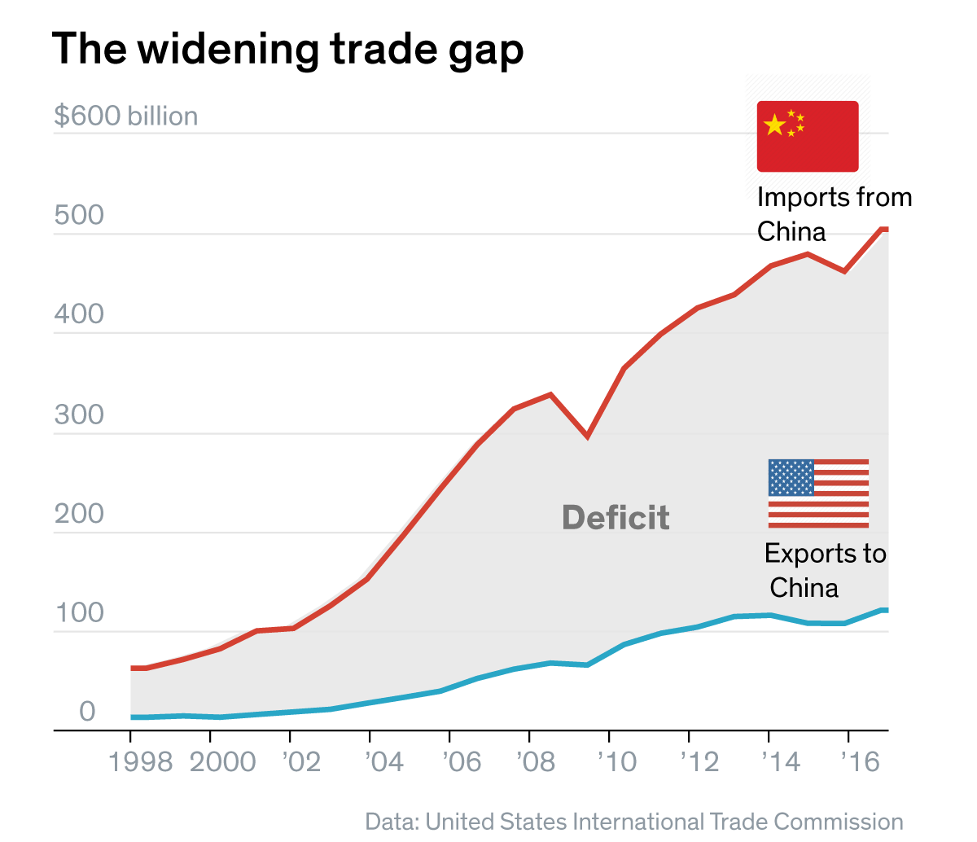
Appendix – Trade Gap

Slide 17
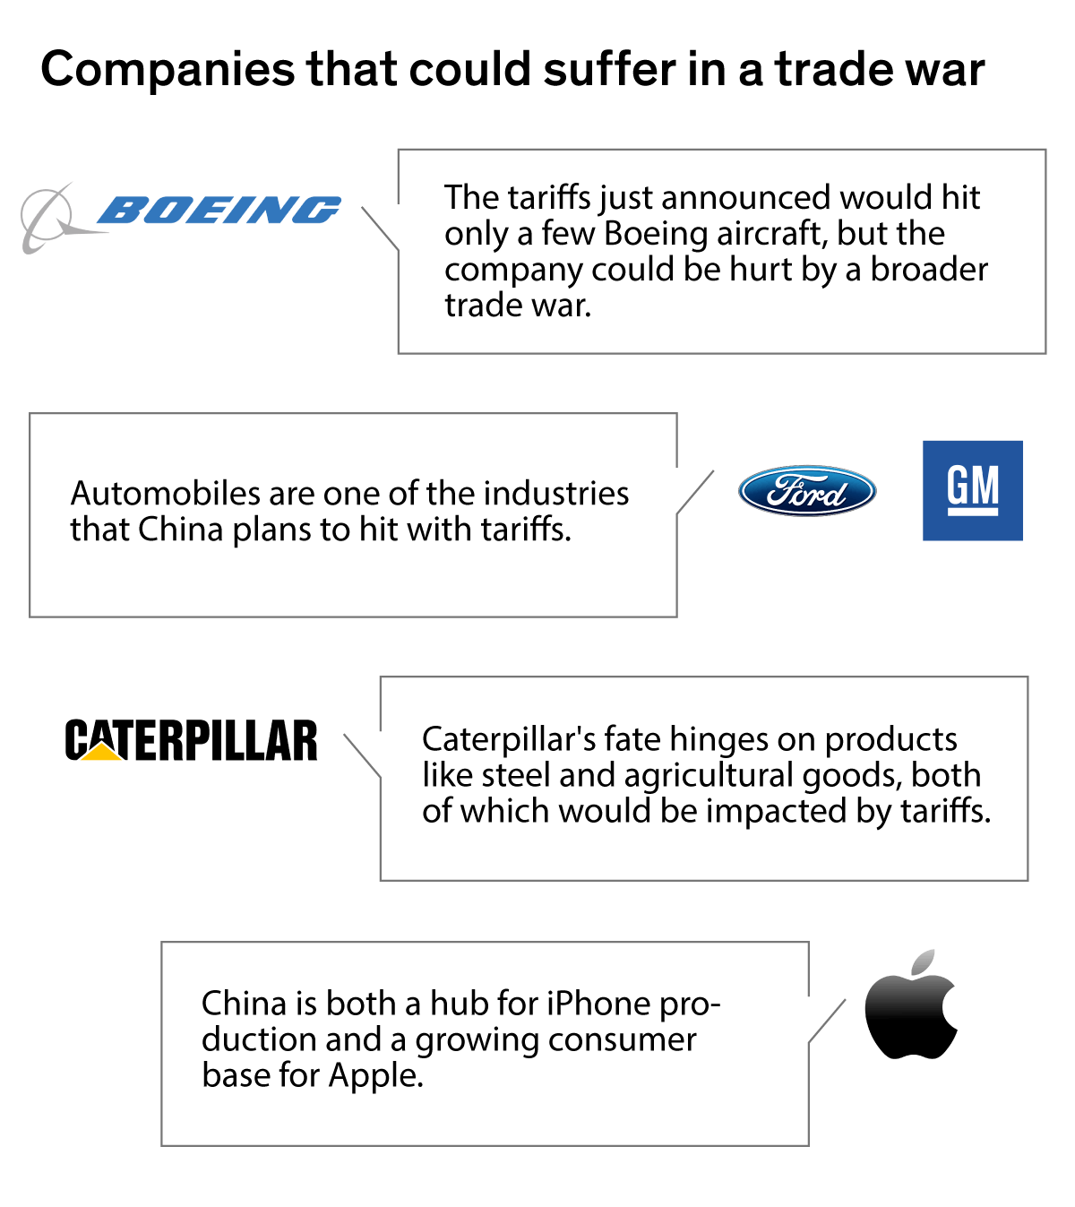
Appendix – Companies Could Suffers from Trade War

